Slide 1
OOP152 – OBJECT-ORIENTED PROGRAMMING
2024

Slide 2
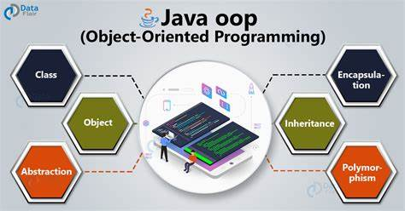
Object-oriented programming (oop152)

Slide 3
Access: Books / Eclipse ide / MS office…etc.

Slide 4
PRESCRIBED Textbook
Think Java: How to Think Like a Computer Scientist Downey, A.B. and Mayfield, C. (2019) Version 6.1.3

Slide 5
TOPIC 3 Objects

Slide 6
ADVANCED OBJECT CONCEPTS
OUTLINE
Objects
The Null Keyword
Garbage Collection
Class Diagrams
Java Library Source

Slide 7
ADVANCED OBJECT CONCEPTS

Slide 8
Null keyword

Slide 9
ADVANCED OBJECT CONCEPTS
Objects
Introduction to null
In Java, the keyword null represents a special value that means "no object.“
It is used when you declare an object variable that does not refer to any object.

Slide 10
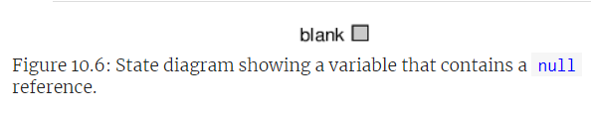
ADVANCED OBJECT CONCEPTS
Objects
Declaring and Initializing with null
Example:
Point blank = null;
In state diagrams, null is shown as a small box with no arrow.

Slide 11
ADVANCED OBJECT CONCEPTS
Objects
Consequences of Using null
Trying to use a null reference by accessing an attribute or invoking a method results in a NullPointerException.
Examples:
Point blank = null;
int x = blank.x; // Throws NullPointerException
blank.translate(50, 50); // Throws NullPointerException

Slide 12
ADVANCED OBJECT CONCEPTS
Objects
Legal Uses of null
It is legal to pass a null reference as an argument or receive one as a return value.
Often used to represent special conditions or indicate errors.

Slide 13
ADVANCED OBJECT CONCEPTS
Objects
Additional Notes:
Ensure to handle null properly in your code to avoid NullPointerException and maintain robustness.

Slide 14
garbage collection

Slide 15
ADVANCED OBJECT CONCEPTS
Objects
Introduction to Garbage Collection:
When no variables refer to an object, it cannot be accessed by the program.
Although invisible to the programmer, the object still occupies memory.

Slide 16
ADVANCED OBJECT CONCEPTS
Objects
Example of Dereferencing an Object:
Point blank = new Point(3, 4);
blank = null;
First line: Creates a new Point object.
Second line: Dereferences the object by setting blank to null.

Slide 17
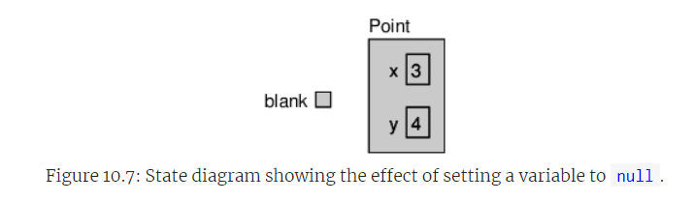
ADVANCED OBJECT CONCEPTS
Objects
Visual Representation:
After dereferencing, the connection between the variable and the object is removed (as shown in hypothetical Figure 10.7).

Slide 18
ADVANCED OBJECT CONCEPTS
Objects
Garbage Collection Process:
Objects that are no longer referenced are eligible for garbage collection.
Java's garbage collector reclaims the memory used by these objects automatically.

Slide 19
ADVANCED OBJECT CONCEPTS
Objects
Programmer's Perspective:
Typically, you don't need to manually manage memory.
Unreferenced objects are automatically collected, freeing up resources.

Slide 20
ADVANCED OBJECT CONCEPTS
Objects
Performance Considerations:
Garbage collection can cause brief pauses in high-performance applications.
These pauses are usually not noticeable but can affect performance when they occur.

Slide 21
Class diagram

Slide 22
ADVANCED OBJECT CONCEPTS
Objects
Introduction to Objects:
Point and Rectangle objects have distinct attributes and methods.
Attributes represent the data of an object.
Methods represent the functionality (code) of an object.

Slide 23
ADVANCED OBJECT CONCEPTS
Objects
Class Definition:
A class defines the attributes and methods its objects will possess.
Example
public class Point {
int x;
int y;
void move(int dx, int dy) {
x += dx;
y += dy;
}
}

Slide 24
ADVANCED OBJECT CONCEPTS
Objects
Unified Modelling Language (UML):
UML provides a standard way to visualize class designs.
UML diagrams are divided into two parts:
Top half for attributes
Bottom half for methods
UML format is language-independent (e.g., x: int instead of int x).

Slide 25
ADVANCED OBJECT CONCEPTS
Objects
Class Diagrams vs. State Diagrams:
Class diagrams show the static structure of classes at compile-time.
State diagrams visualize the dynamic state of objects at run-time.

Slide 26
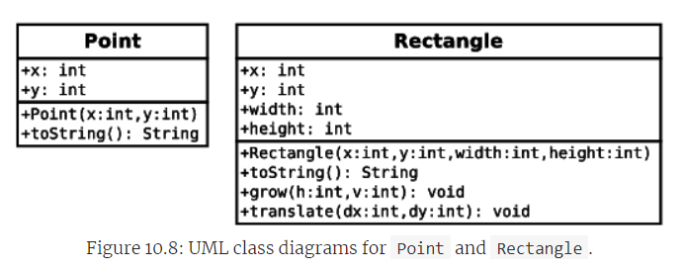
ADVANCED OBJECT CONCEPTS and classes
Objects
Example UML Class Diagram:
Attributes and methods for Point and Rectangle are listed.
Example UML snippet for Point and Rectangle:

Slide 27
ADVANCED OBJECT CONCEPTS
Objects
Documentation and Further Learning:
Point and Rectangle classes include additional methods not covered here.
Refer to the class documentation for comprehensive details on capabilities.

Slide 28
java library source

Slide 29
ADVANCED OBJECT CONCEPTS
Objects
Location of Library Source Code
Stored in a file named src.zip.
Linux: Typically found under /usr/lib/jvm/openjdk-8/ (may require installing openjdk-8-source package).
OS X: Usually located under /Library/Java/JavaVirtualMachines/jdk.../Contents/Home/.
Windows: Commonly found under C:\Program Files\Java\jdk...\.

Slide 30
Exercises

Slide 31
ADVANCED OBJECT CONCEPTS
Exercises:
See Participation.

Slide 32



